Slide 1

PROFESSIONAL CERTIFICATE
IN MACHINE LEARNING AND
ARTIFICIAL INTELLIGENCE
Office Hour #13 with
Ali Chaudhry
Dec 08, 2023 at 3 pm UTC

Slide 2
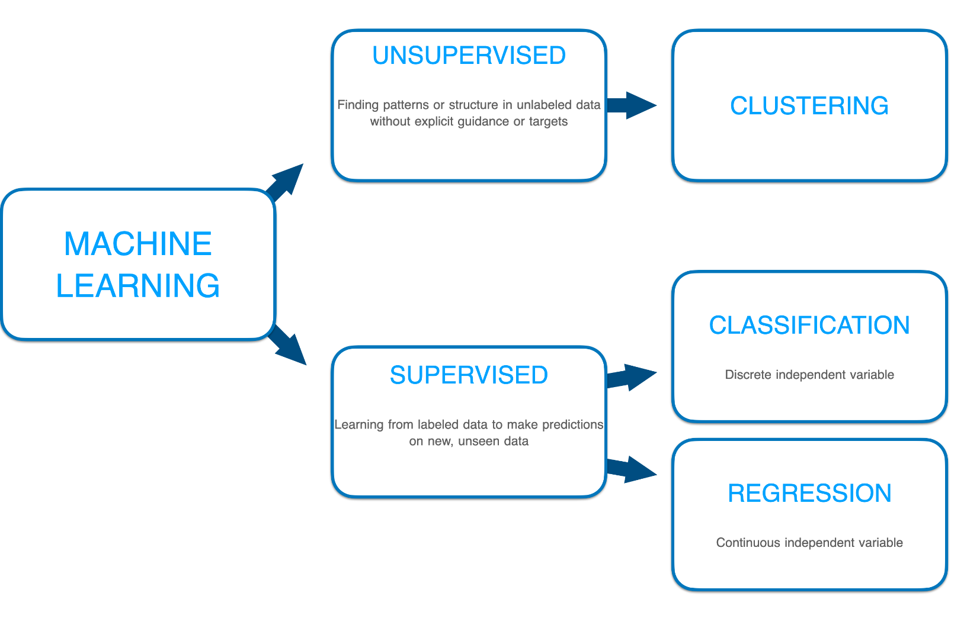
ML Fundamentals

Slide 3
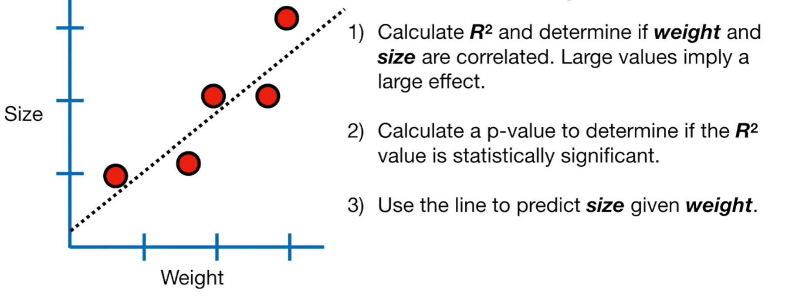
Linear Regression

Slide 4
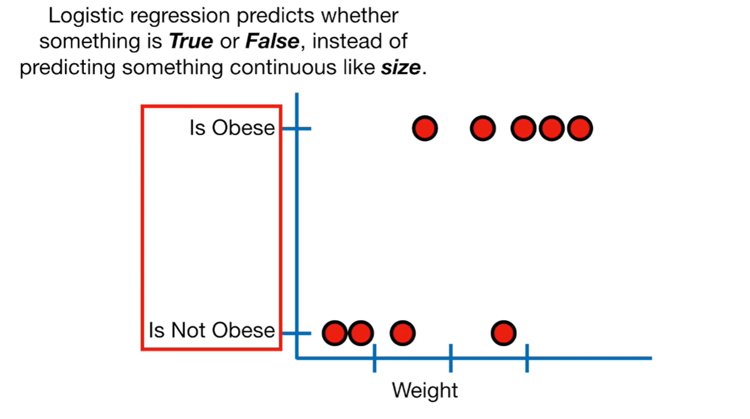
Logistic Regression

Slide 5
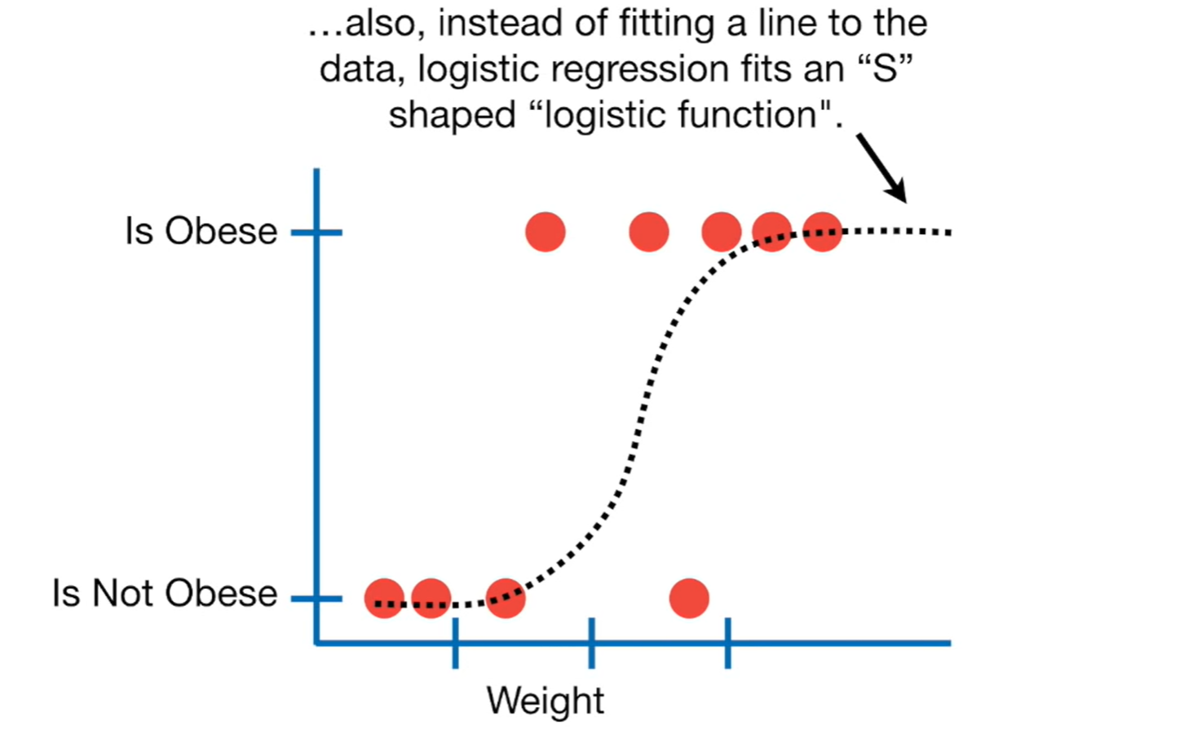
Logistic Regression

Slide 6
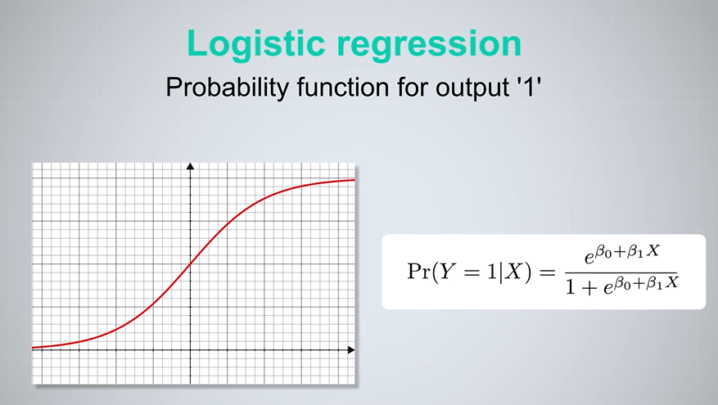
Logistic Regression

Slide 7
Prepare Data for Logistic Regression
Binary Output Variable: Logistic regression is intended for binary (two-class) classification problems. It will predict the probability of an instance belonging to the default class, which can be snapped into a 0 or 1 classification.
Remove Noise: Logistic regression assumes no error in the output variable (y), consider removing outliers and possibly misclassified instances from your training data.
Gaussian Distribution: Logistic regression is a linear algorithm (with a non-linear transform on output). It does assume a linear relationship between the input variables with the output. Data transforms of your input variables that better expose this linear relationship can result in a more accurate model. For example, you can use log, root, Box-Cox and other univariate transforms to better expose this relationship.
Remove Correlated Inputs: Like linear regression, the model can overfit if you have multiple highly-correlated inputs. Consider calculating the pairwise correlations between all inputs and removing highly correlated inputs.
Fail to Converge: It is possible for the expected likelihood estimation process that learns the coefficients to fail to converge. This can happen if there are many highly correlated inputs in your data or the data is very sparse (e.g. lots of zeros in your input data).

Slide 8

Group Discussion
What can be applications of logistic regressions?
.

Slide 9
Logistic Regression Applications
Credit scoring: It’s difficult if you have more than 15 variables in your model. For logistic regression, it is easy to find out which variables affect the final result of the predictions more and which ones less. It is also possible to find the optimal number of features and eliminate redundant variables with methods like recursive feature elimination
An e-commerce company that mails expensive promotional offers to customers, for example, would like to know whether a particular customer is likely to respond to the offers or not: i.e., whether that consumer will be a "responder" or a "non-responder." In marketing, this is called propensity to respond modeling.
Healthcare: discrimination between type 1 and type 2 diabetes in young adult
More details: https://activewizards.com/blog/5-real-world-examples-of-logistic-regression-application

Slide 10
Logistic Regression Many Features
Techniques to Reduce the Number of Features
PCA: this creates "new" linear combinations of your data where each preceding component explains as much variance in the data as possible. The disadvantage here is that because the components are combinations of your original variables you lose some interpretability with your regression model. It should however produce very good accuracy.
Lasso Regression uses an L1 penalization norm that shrinks the coefficients of features effectively eliminating some of them.You can include this L1 norm into your logistic regression model. It seems Note: Lasso will not explicitly set variable coefficients to zero, but will shrink them allowing you to select the largest coefficients.
Notes:
Principal component analysis

Slide 11
Multi-Class Logistic Regression
Eg. If we have to predict whether the weather is sunny, rainy, or windy, we are dealing with a Multi-class problem. We turn this problem into three binary classification problem i.e whether it is sunny or not, whether it is rainy or not and whether it is windy or not. We run all three classifications independently on input. The classification for which the value of probability is maximum relative to others, is the solution.
Assumptions:
The Dependent variable should be either nominal or ordinal variable.
Set of one or more Independent variables can be continuous, ordinal or nominal.
The Observations and dependent variables must be mutually exclusive and exhaustive.
No Multicollinearity between Independent variables.
There should be no Outliers in the data points.
Notes:
Nominal variable is a variable that has two or more categories but it does not have any meaningful ordering in them. For example, (a) 3 types of cuisine i.e. Indian, Continental and Italian. (b) 5 categories of transport i.e. Bus, Car, Train, Ship and Airplane.Ordinal variable are variables that also can have two or more categories but they can be ordered or ranked among themselves. For example, Grades in an exam i.e. A-excellent, B-Good, C-Needs Improvement and D-Fail. When ordinal dependent variable is present, one can think of ordinal logistic regression.Continuous variables are numeric variables that can have infinite number of values within the specified range values. For example, age of a person, number of hours students study, income of an person.
Multicollinearity occurs when two or more independent variables are highly correlated with each other. This makes it difficult to understand how much every independent variable contributes to the category of dependent variable. Also makes it difficult to understand the importance of different variables.
Mutually exclusive means when there are two or more categories, no observation falls into more than one category of dependent variable.
The categories are exhaustive means that every observation must fall into some category of dependent variable.
Ordinal variables should be treated as either continuous or nominal.

Slide 12
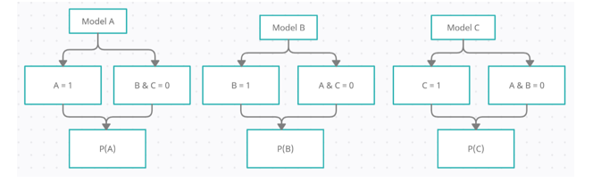
Multi-Class Logistic Regression
K models for K classes
Notes:
Kmodel: This is the simplest approach where k models will be built for k classes as a set of independent binomial logistic regression. For Example, there are three classes in nominal dependent variable i.e., A, B and C. Firstly, Build three models separately i.e. Class A vs Class B & C, Class B vs Class A & C and Class C vs Class A & B. During First model, (Class A vs Class B & C): Class A will be 1 and Class B&C will be 0. In second model (Class B vs Class A & C): Class B will be 1 and Class A&C will be 0 and in third model (Class C vs Class A & B): Class C will be 1 and Class A&B will be 0. Next develop the equation to calculate three Probabilities i.e. P(A), P(B) and P(C), very similar to the logistic regression equation. Predicting the class of any record/observations, based on the independent input variables, will be the class that has highest probability. For a record, if P(A) > P(B) and P(A) > P(C), then the dependent target class = Class A.
Simultaneous models; For K classes/possible outcomes, we will develop K-1 models as a set of independent binary regressions, in which one outcome/class is chosen as “Reference/Pivot” class and all the other K-1 outcomes/classes are separately regressed against the pivot outcome.
When K = two, one model will be developed and multinomial logistic regression is equal to logistic regression.
For two classes i.e. Class A and Class B, one logistic regression model will be developed and the equation for probability is as follows:
If the value of p >= 0.5, then the record is classified as class A, else class B will be the possible target outcome.
For Multi-class dependent variables i.e. for K classes, K-1 Logistic Regression models will be developed. Let’s say there are three classes in dependent variable/Possible outcomes i.e. Class A, B and C.
Since there are three classes, two logistic regression models will be developed and let’s consider Class C has the reference or pivot class.
https://www.mygreatlearning.com/blog/multinomial-logistic-regression/
First Model will be developed for Class A and the reference class is C, the probability equation is as follows:
Develop second logistic regression model for class B with class C as reference class, then the probability equation is as follows:
Once probability of class C is calculated, probabilities of class A and class B can be calculated using the earlier equations.
Same logic can be applied to k classes where k-1 logistic regression models should be developed.
There are other approaches for solving the multinomial logistic regression problems.

Slide 13

QUESTIONS?

